Slide 1
Tips for Medical
Scientific Experts
Module 2:
Verbal and Visual Aspects
Verbal-and-Visual-Aspects
© Dr. Günter Umbach www.umbachpartner.com
Notes:
Effective and magnetic presentations

Slide 2
Modes of Expression
Notes:
Ähnlich wie bei einem Meisterkoch: Sie brauchen die richtigen Zutaten in Form der richtigen Worte. Sie fabrizieren keine neuen Wörter, sondern wählen die richtigen Worte aus dem Sprachschatz Ihrer Muttersprache aus. Dabei müssen Sie etwas Neues schaffen, Ihren Konkurrenten nachahmen reicht nicht. Kernaussage besteht aus Markenvokabular
Power message
Der Begriff Slogan ist aus der Mode gekommen. Der englische Begriff Claim wird im Marketing, vor allem in der Werbung häufig in derselben Bedeutung wie Slogan verwendet. Crystallized brand promise / Brand benefit edge

Slide 3
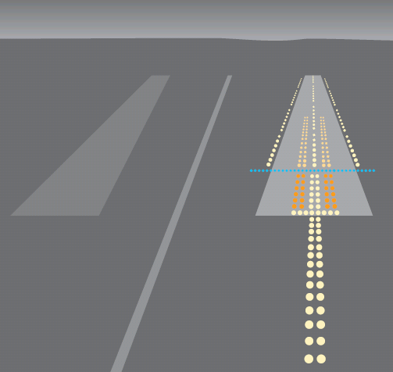
Your Audience

Slide 4
Words
Choose carefully
Notes:
Words, in other words your language can determine how people feel and how they react to you.

Slide 5
Nephrologists:
Kidneys, renal function,
Glomerular filtration rate …
Cardiologists:
Heart, vessels, cardiovascular function, ejection fraction …
Notes:
Love to talk about …

Slide 6
Oncologists:
Oncology, overall survival …
…
Notes:
Love to talk about …

Slide 7
Vocabulary
Do a spell check
(with WORD)

Slide 8
Speak the truth,
but speak it pleasantly
Zarathustra, 1000 B.C.

Slide 9
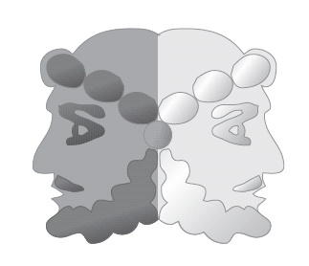

Slide 10
Make the message positive:
Use affirmative statements
There is no other way …
There is only one way …

Slide 11
Wording
Significant
Careful!
Clear
Substantial

Slide 12
Wording
Reduction in complaints
Clinical improvement

Slide 13
p value
p < 0.0001
p < 0.01

Slide 14
- +
No negative effect on the metabolism
Metabolically neutral
?

Slide 15
-
10% of patients
die within 5 years
90% of patients
are alive after
5 years
[Dr. med. Günter Umbach – Bonn]

Slide 16
- +
Examplex
reduces
mortality
Examplex
prolongs
survival

Slide 17
- +
Fewer side
effects
Better
tolerability

Slide 18
Attractive Headlines
-
•
• • •
Analysis
Results
Summary
Conclusions
Lessons learned
Notes:
What motivates people to read your article?

Slide 19
One option is 20% superior
? ? Clear
20%
difference
20%
increase
20%
improve-
ment
Notes:
How do you express this data?

Slide 20
Alternatives to 'Prove'
Validate
Document
Confirm
Highlight
Support
Emphasize
Underline

Slide 21
You
misunderstood
me
Let
me
explain
Notes:
Vermeide "Stacheldrahtworte" mit negativen Bedeutungen. Machen Sie einen "Semantik-Check", damit Sie sich nicht im Irrgarten der Worte verlaufen - Die Macht einzelner Worte kann man kaum unter-schätzen. Man kann sich damit selbst demontieren und sabotieren. Worte sind wie Feuer; Sie können es beim Heizen dazu benutzen, um Ihr Haus auf eine wohlig-warme Raumtemperatur zu wärmen oder um - wie ein Brandstifter - Ihr Haus bis auf die Grund-mauern niederzubrennen. Passen Sie auf bei Worten, die mit "ver" beginnen wie verblühen, verwelken, verderben - sie haben oft eine negative Bedeutung. Unglückliche Wortungeheuer, die zu einem neuen unglücklichen Frankenstein zusammen-gebaut werden - so entstehen wahre Texte des Grauens. Ministerpräsident Mappus in BW: "Ich nehme den Fehdehandschuh der Demonstranten an" Sein Medienberater riet ihm dringend davon ab, diesen Begriff jemals wieder zu verwenden

Slide 22
Impact
People should be able
to read your charts
Notes:
Pay attention to everything.
Complex = unclear and diffuse.
Find out th essential and keep details for specialists.
I am a former research fellow in cancer research. I know how complex scientific data can be. I know that you first need to analyze all the data

Slide 23

Notes:
You are not an ophtalmologist who checks people's eye sights or visual acuity.
Dies ist kein Sehtest …
If people cannot read your slides, they might as well be invisible.

Slide 24
Charts
Most frequent mistake
Poor legibility
Most frequent reason:
Font size too small …
Notes:
In your presentation charts use
letters that are big enough to read
for people sitting in the last row,
for example 40 points.
Ein Fehler, den ich immer wieder beobachte. Die Schriftgrösse in Foldern, Broschüren und Webseiten ist zu klein, um gut leserlich zu sein.

Slide 25
Font size too small

Slide 26
Type of Typography
Notes:
How to increase easy readability with the right typeface or Font.

Slide 27
Common Fonts
Rare
Fonts
Arial
Calibri
Tahoma
Microsoft Sans Serif

Slide 28
Negative Typography
Positive Typography

Slide 29
CAPITALS
THIS TRIAL CONFIRMS THAT
SUBSTANTIN CAN IMPROVE …
Use upper and lower
case letters
This trial confirms that
substantin can improve …

Slide 30
This trial confirms that substantin
can improve ..
Stay away from italic style
This trial confirms that substantin
can improve …

Slide 31
This trial confirms that substantin
can improve …
Avoid underlining
This trial confirms that substantin
can improve …
Notes:
Avoid underlining since underlined words are difficult to read

Slide 32
This trial confirms that substantin
can improve …
Use line spacing > 1.1
This trial confirms that substantin
can improve …

Slide 33
Colours
Light-coloured letters on a
light-coloured background
are difficult to read
Ensure sufficient contrast

Slide 34

Some people love
backgrounds
(wallpaper style)
Use a white or light
background

Slide 35
Second
Best Number
of Bullet Points
Best Number
of Bullet Points
•
•
•
•
•
•
•
•
"Triplet" …

Slide 36
Avoid "Unlucky" Numbers
17
13
4
Italy Europe China

Slide 37
Different ways to express
your content

Slide 38
Speed of processing
information
Text
Table
Diagram
Image
S l o w
Medium
Rapid
Very rapid
Notes:
Necessary for Understanding

Slide 39
Diagrams

Slide 40
Note
Do not "copy and paste"
files or scanned documents
into your key charts
…
Will be difficult to read

Slide 41
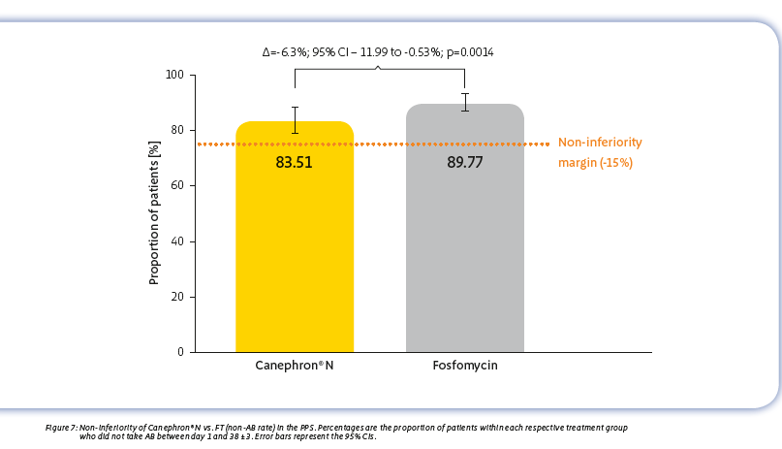
Print
Scanned Diagram

Slide 42
Better Diagram
Fosfomycin vs Canephron in lower uncomplicated urinary tract infections
-
-
80
Non-
inferiority
Margin
-
--------------------------------------------------------------------------------
-
89.8
83.5
60
% of patients
-
-
40
-
-
20
-
Fosfomycin Group
Canephron Group
Similar percentages of patients not
needing an additional antibiotic
Urol Int, DOI: 10.1159/
000493368

Slide 43
Do not read your slides …
They are called visual aids for a reason …
Notes:
First of all: You are not obliged to show slides.
Visuals can enhance a presentation.
Do not blame your software if your slides are poor - you made them.
There is even a book called "powerpoint surgery".
Do not hide behind your slides.
Turn on/off on PowerPoint: B or W key

Slide 44
Ask: Essential Charts
Which 20% of my charts
produce 80% of the impact
that I wish to generate?

Slide 45
Example One, Version 1
Substantin reduces endpoint
by 75% (from 100 to 25),
compared to the control group.

Slide 46
Example One, Version 2
Endpoint
Control
Substantin
100
25

Slide 47
Example One, Version 3
Endpoint
75%
Control
Substantin

Slide 48
Example Two, Version 1
Results: Recall
Improvement
Same
Deterioration
50%
48%
2%

Slide 49
Example Two, Version 2
Same
48%
Improvement
50%
Deterioration
2%

Slide 50
Example Two, Version 3
Improvement
Same
50%
48%
Deterioration

Slide 51
Legends on Diagrams
Give meaning to particular elements like colors

Slide 52
Control
Substantin

Slide 53
Control
Substantin
?

Slide 54
Control
Substantin

Slide 55
Sequence of Columns
in Diagrams

Slide 56
Substantin
Control

Slide 57
Control
Substantin

Slide 58
Colors in Diagrams

Slide 59
Placebo or Control: Color?
Grey

Slide 60
Statement Below Diagram
80
p < 0.05
75
Examplex
GFR (ml/min)
70
Control
65
60
1
2
3
4
Time (years)
Examplex helps to maintain renal function

Slide 61
Outcome
Selected aspect
Relative Risk
Primary
Endpoints
0.6
1.0
1.4
Examplex better Control better

Slide 62
Outcome
Comprehensive
Relative Risk
Primary
Endpoints
Primary and
Secondary
Endpoints
0.6
1.0
1.4
Examplex better Control better

Slide 63
Statistical Analysis
Standard Examplex
Standard Examplex
Intention-to-Treat
Per-Protocol
…
Notes:
Datenauswertungsprinzip: Es werden nur die Ergebnisse derjenigen Probanden berücksichtigt, die sich prüf-plankonform verhalten haben, das heisst die die zugewiesene Behandlung auch tatsächlich erhalten haben. Ergebnisse von Probanden, die vorzeitig aus der Studie ausgeschieden sind, die die Medikation abgesetzt haben, in eine andere Studien-gruppe gewechselt sind oder auf sonstige Weise das Studien-protokoll nicht erfüllt haben, fließen also nicht in die Analyse mit ein.

Slide 64
If you have the copyright
©
Notes:
Avoid numbering the pages

Slide 65
Avoid Numbering
10 of 80
Notes:
Avoid numbering the pages

Slide 66
What will the Audience Think?
Oh, how long will
this speaker take?
Notes:
Let me tell you a real story that happened at a conference in Frankfurt last month. I was the master of ceremony (in German: Der Moderator). One of the speakers that was due to start at 2 pm arrived just 2 minutes prior to the start of his presentation - and that was the first thing he said. The consequence: We will never invite him again.
Oh, so many more charts
to go - I have to hurry up

Slide 67
Avoid Long Footers
Department of ABC, Institute of DEF, University Hospital GHI, City of JKL, Country
Notes:
Not a good idea, because it is distracting

Slide 68

Layout (Vertical)
Text
.............
.............
.............
.............
.............
.............
.............
Text
.............
.............
.............
.............
.............
.............
.............
?
Notes:
Combine Picture and Text

Slide 69
Layout (Horizontal)
Text
.......................
........................
........................
?
Text
.......................
........................
........................

Slide 70
Animation
Use sparingly
Best:
Wipe
Notes:
In the Western world: Wipe from left to right

Slide 71
Use images

Slide 72
Intima-Media-Thickness
Intima-Media-
Thickness

Slide 73
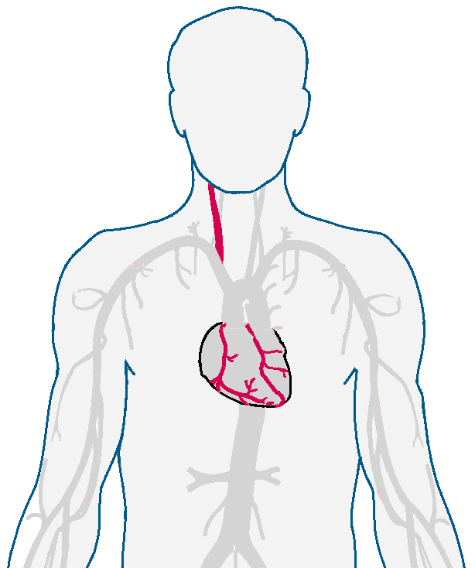
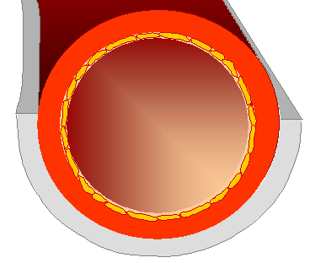
Intima-Media-Thickness
Intima-Media-
Thickness

Slide 74
Impact
1) Visual elements (pictures …)
2) Headlines, statements below pictures
3) Subheadlines, bullet points
4) Regular text ("copy", "Fließtext")

Slide 75
Design

Slide 76
Resist the Temptation
- Embellishments
- Decorations
- Ornaments
- "Make it beautiful"

Slide 77
Keep it clean

Slide 78
Communicator
Fancy
Colourful
Clean
Compelling
Straightforward
Decorative
Circus Look
Impact
Notes:
Original
Artist
Do not "embellish"
Do not use
standard clip art
(Royalty-free images
and illustrations)

Slide 79
Frames
C B A Placebo Examplex

Slide 80
C B A Placebo Examplex

Slide 81
Emotional Impact
Address feelings

Slide 82
Be the Voice
Articulate what other people think and feel
but are afraid to say

Slide 83
Tell a human interest story only one person can tell
You ...
Data get dumped, stories stick
Notes:
Problem = Herausforderung
Es geht nicht um eine Produktstory, sondern um einen Menschen mit ganz konkreten Problemen, und wie man ihm mit dem Produkt helfen kann

Slide 84
Example
Case study
Telling a real story
"Super Power"
Notes:
Teilweise wie ein symbolischer Spiegel, in dem Sie Ihre eigenen Fähigkeiten und Kenntnisse wiedererkennen und sich dabei folgende Fragen stellen

Slide 85

• Patient
• Physician
• Investigator
or about even you
Notes:
Teilweise wie ein symbolischer Spiegel, in dem Sie Ihre eigenen Fähigkeiten und Kenntnisse wiedererkennen und sich dabei folgende Fragen stellen

Slide 86

…
Who is in
the center of
your story?
Marie
Notes:
Let us start with a case study.
Probably, many of you have children. My wife and I have got 3 children. This is Marie, our first (and currently only) granddaughter
And she is dear to my heart.
Recently she had a cough.
I recommended giving her Prospan: I was the recommender or influencer.
My wife said yes, good idea. She was the decision maker.
Marie's mother who is my daughter, administered the medicine.
Little Marie is of course the patient receiving the medicine.
By the way, Marie recovered quickly and was able to play happily with her friends again.

Slide 87
This concludes module 2
Notes:
Less is more.
You do not get more credit for telling more.
Pay attention to everything.
Complex = unclear and diffuse.
Find out the essential and keep details for specialists.
I am a former research fellow in cancer research. I know how complex scientific data can be. I know that you first need to analyze all the data

