Slide 1
Tips for Medical
Scientific Experts
Module 1
How to Prepare a
Great Presentation
How-to-Prepare-a-Great-Presentation
© Dr. Günter Umbach www.umbachpartner.com
Notes:
Effective and magnetic presentations

Slide 2

Objectives

Slide 3
• • • • • • • • • • • • • • • • • • • • • • • • • • • • • • • • •
• • • • • • • • • • • • • • • • • • • • • • • • • • • • • • • • •
Make you successful
Notes:
I am looking at it through certain glasses.
Trainer and consultant. The lens is not academia
or theory taught at universities and the lens is not the anonymous overall corporate profit. The workshop must be immediately useful to you.

Slide 4
Help you
• Give effective presentations
• Increase your impact
• Enhance your communication skills
• Engage your audience

Slide 5
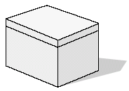
Toolbox
Notes:
Road map
Methodology
Templates
Easy to follow steps
Practical tips and techniques
Based on:
- Direct-response mailings
- Tests in advertising
- Online marketing performance
- Learning psychology
- Personal experience as speaker
Of course no randomized clinical trials with a p-value
I would like to share some tools and idea with you that help you enhance your communication skills, especially how you prepare and handle your presentation.
You want people to equate your presentation with excellence.
That is a very valuable skill - useful for every situation where you would like to get an idea across - both in your private life and in your professional life.
We will talk about preparation, about language, about making a connection with your audience, about how to be persuasive.
All my tips tried, tested and confirmed and are based on approximately 40 years of experience as speaker, trainer and lecturer.

Slide 6

You choose
Notes:
Wählen Sie wie bei einem Büffet aus, was für Ihre jeweilige Situation relevant ist. Sie sind die Experten für Ihr Produkt, Ihre Zielgruppe, Ihr Umfeld und was in Ihrem Unternehmen möglichkeit.

Slide 7
Reservoir
Notes:
You will be reminded of things you already know,
but forgot to pay attention to.
Lassen Sie sich von Ihren eigenen Ideen inspirieren. In uns allen schlummern ungeborene Ideen und Konzepte. Unser Unterbewusstsein ist wie ein unterirdisches Reservoir, in dem kreative, originelle Gedanken im Verborgenen lagern. Zapfen Sie dieses Reservoir an und fördern Sie diese Ideen zu Tage, bringen Sie sie ans Tageslicht. Heben Sie die verborgenen Schätze in Ihrem Ideenspeicher. Nutzen Sie die ungenutzte
Energie. Erwecken Sie die schlafenden Konzepte zum Leben. Nutzen Sie die ungenutzte Talente
In jedem von uns steckt mehr, als wir manchmal glauben. Fördern Sie sich und fordern Sie sich!
Setzen Sie Ihre gesamte Energie frei!
Tap into your hidden reservoir of creative thoughts and unborn concepts just waiting for a trigger to emerge

Slide 8

Notes
Notes:
Und wenn Sie eine solche Idee oder einen Einfall haben: Bitte halten Sie dies auf Papier fest, bevor Sie sie vergessen - und das wäre schade. Was man aufschreibt, kann man nicht vergessen. Was man vergessen hat, kann man nicht mehr aufschreiben.
Research has shown that - if you don't write it down immediately - you run a high risk of forgetting it. And it would be a pity if an innovative idea is lost. Schreiben Sie, auf, was Ihnen in den Sinn kommt, notieren Sie, was für Sie wichtig ist. Use them or loose them

Slide 9

Operating Modes
High-Content
Speaker
at event
Researcher/
Investigator
Practising
Physician
Notes:
Operating Systems: How you function.
High-Content means: Expert.
Now there are many experts out there,
But there are only few good speakers.
And there is a great need for great speakers.
The good news:
That is a skill you can learn if you are serious about it.
if you are serious about it

Slide 10
"Speaker for the General Public"
- Magicians
- Comedians
- Quiz show hosts
- Motivational
speakers …
Expert
presenting
at a Medical
Scientific
Conference
Creating an experience
Notes:
Now you have the role of participant.

Slide 11

You are giving a performance
Notes:
I am given a performance right now.
Give a convincing performance
Engage your listeners.
In fact I am now giving a performance right now.

Slide 12
How do you want
to come across?
Competent and confident, but not overconfident …
Notes:
Avoid Arrogance

Slide 13
Especially in Europe and Asia
Make your audience feel
- important
- understood
- comfortable
Notes:
Avoid Arrogance

Slide 14

4th Operating Mode
Workshop
Notes:
Operating Systems: How you function.
Now you have the role of participant.

Slide 15


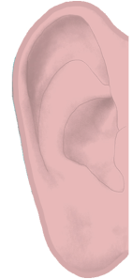
Publication Presentation
Read
Speak
Words
Words
"Minds move
faster than lips"
Notes:
conveying information
Minds move faster than lips

Slide 16
Your in-person presentation is
five
_________
times as effective as people reading publications …
Notes:
You want to make your presentation worthwhile for the audience.
What you do matters.
Participating 5x as effective as Reading
How to increase recall:
When you give a presentation, people will remember five times as much as if they
read your email.

Slide 17
Your Job is not
just to give large
amounts of data
(People can read the publications)
…
Notes:
Due to your upbringing, your education, your experiences, your style

Slide 18
… to give
- explanations
What is the underlying mechanism?
- insights ("aha moments")
Why this is happening?
- advice
What are the implications?
Notes:
What to do = A call to action

Slide 19

Make Meaning
•
•
•
•
•
•
•
Making science make sense
Notes:
Sinn und Bedeutung geben
What should your customer perceive?
Wahrnehmungen kann man lenken
Inszenieren

Slide 20
Connecting the dots
Notes:
Shakespeare

Slide 21
Mindset
"All the world is a stage"

Slide 22

electrifying or
extravagant
performances
We are
not actors
but we can learn from actors
Notes:
Shakespeare

Slide 23
Prepare
Before

Slide 24
Arrive early
(the evening before)

Slide 25
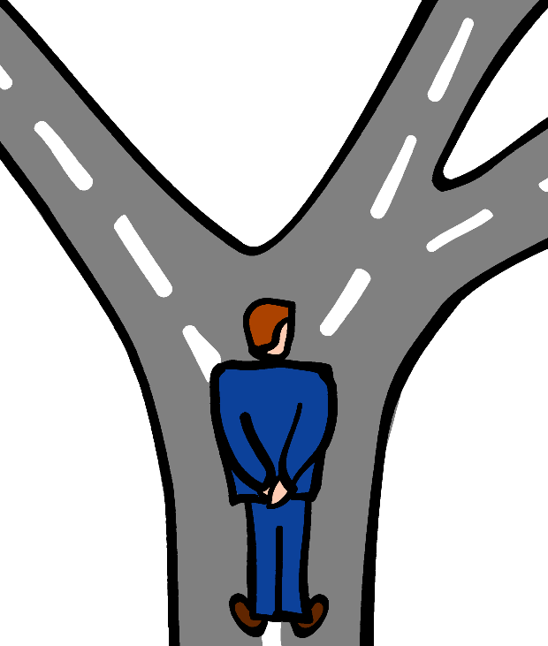
Part of Your Preparation
Rehearse your
answers to
questions that
might be asked

Slide 26
In case you must present longer
Have one chart with the
3 most frequent questions

Slide 27
Your Technical Back-up
• Bring your USB stick
• Email charts to yourself
• Store charts in the cloud
Notes:
Show USB-Stick
You always need a plan B
Print major points

Slide 28
Ensure technical equipment
- Laptop
- Cables
- Adapters
(VGA, HDMI, Display Port)
- Large audience: Microphone
…
Just in case:
A physical print-out or a second laptop
Notes:
Show USB-Stick
You always need a plan B
Print major points

Slide 29
Do not rely on wifi
Your internet connection
might work fine - until …
hundreds of people switch on their
smartphones and suck up bandwidth
Wired broadband connection
(ethernet cable)
Store files (e.g. videos) locally
Notes:
The hotel says, sure we've got a fast internet connection via wifi.
Testing is perfect

Slide 30
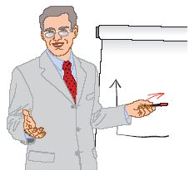
Consider a Flip Chart
For smaller audiences

Slide 31
Flip Chart
Ensure it is put in the right place before you start
Bring your own marker pen
(blue or black colour)

Slide 32

Turn off

Slide 33
Before Your Presentation
Speak to
- Chairperson
- Co-speakers …
Notes:
Relationship Building

Slide 34
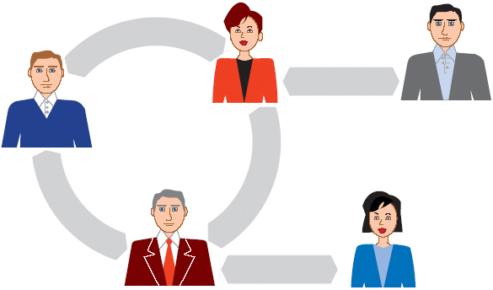
Connect to
Members of the audience
"Networking"
Notes:
Relationship Building

Slide 35
For Smaller Groups
Mention a conversation you
Had before your presentation
"I just talked to … and he
said: It is important to give
practical tips"

Slide 36
During

Slide 37
Tips for the
Stage / Platform

Slide 38
Watch your steps
(entering and leaving)

Slide 39

When possible
Get out from
behind the
lectern
"Barrier between you
and the audience"

Slide 40
Pace
Speak slowly
Notes:
Pace or Speed

Slide 41
Impact
Golden Triangle

Slide 42
"3 Drivers"
• Content Scientific data
• Modes of Expression
How you articulate and illustrate
• Delivery
"Stage Performance"
Notes:
Your valuable content deserves and merits the best modes of expression and the best form of delivery.
Where do you get the most leverage?

Slide 43
Opening Section
Learning: Effective Points
Anchoring bias Recency bias
Notes:
Der Anfang ist schon mehr als die Hälfte - Aristoteles

Slide 44
Build Rapport
Create an emotional
connection to the audience …
Notes:
Relationship Building

Slide 45
Example
A sense of belonging to
the same community
…
Notes:
Relationship Building

Slide 46
Example
Mention something that both
you and your audience share:
Say something that you
have in common …
Trust
Notes:
Relationship Building

Slide 47
Example
Profession
"Since we are all physicians …
Notes:
Relationship Building

Slide 48
Example
Patients
"We are all treating patients with allergies"
Notes:
Internship
Research
My mother is from …

Slide 49
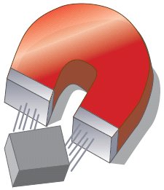
Start
Arouse Curiosity
Notes:
You have to give them something to hang onto

Slide 50
Start
Poor example
"We did a study"
Notes:
Ask questions that will grab the audience's attention, that will have an impact.
Well obiously, this question does not meet the criteria, in fact it is boring.

Slide 51
Rhetorical options
Question
Answer
Notes:
Create Tension

Slide 52
Example
"The Research Question …"

Slide 53
Ask a rhetorical question
Example
"Should we really treat
all patients with … ?"
"The answer: It depends …

Slide 54
Challenge
Solution
Notes:
Create Tension

Slide 55
Example
The problem we face …
Notes:
Wo ist der Engpass? Ohne Problem keine Lösung. Ich: an Flipchart zwei Kreise zeichnen.
Links: Woran Sie interessiert sind: Marktanteile, Umsatz, Gewinn Rechts: Woran der Kunde interessiert ist: Mehr Zeit, mehr Geld, weniger Stress, etc
Without a problem, there is no solution . Why should the doctor care? Doctors seek their own self-interest, exactly like everybody else. How can you help him solve his problem? Are you helping him to find an answer to his question? Do you give him the right kind of support? There must be a fit between his needs and the stuff you offer: You must be offering a solution. Reassuring him that he is on the safe side, telling him that he is doing the right thing, that his treatment is based on solid, sound, scientific evidence, i.e. backed by research data from rigorously performed clinical trials and backed by official recommendations

Slide 56
Past
Present
Before
After
Notes:
Create Tension

Slide 57
Example
Until recently, the conventional treatment was …
Now there is a new option

Slide 58
Baseline
Improvement
You are
filling a gap

Slide 59
Other Interesting Titles

Slide 60
Example
"Update and new trends …"
Notes:
Auf welche Frage suchen Ihre Kunden eine Antwort? Welches Problem wollen Sie gelöst haben?

Slide 61
Example
"3 Myths about …"
Notes:
Auf welche Frage suchen Ihre Kunden eine Antwort? Welches Problem wollen Sie gelöst haben?

Slide 62
Example
"Why …"
Notes:
Auf welche Frage suchen Ihre Kunden eine Antwort? Welches Problem wollen Sie gelöst haben?

Slide 63
Example
"The Pros and Cons of …"
Notes:
Auf welche Frage suchen Ihre Kunden eine Antwort? Welches Problem wollen Sie gelöst haben?

Slide 64

Take them on a
journey of discovery
Notes:
Auf welche Frage suchen Ihre Kunden eine Antwort? Welches Problem wollen Sie gelöst haben?

Slide 65
Understand your audience
Notes:
Less is more.
You do not get more credit for telling more.
Pay attention to everything.
Complex = unclear and diffuse.
Find out the essential and keep details for specialists.
I am a former research fellow in cancer research. I know how complex scientific data can be. I know that you first need to analyze all the data

Slide 66
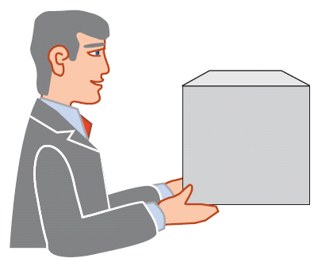

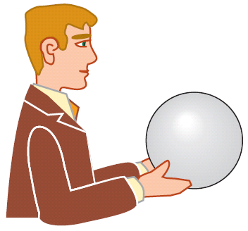
Your presentation should address
the audience's interest
Notes:
People buy for their own reasons, not for yours. Your customer must have solid reasons for wanting to listen to you. Simply pushing the product or study will not product any results. Different customers want different solutions. Not the provider (you) defines the kind of solution they need, the receiver (the customer) defines the kind of support needed. It is your job to find out which kind of support they want. Which customer's interest do you serve?

Slide 67

Main Pitfall
•
•
•
•
•
•
•
•
•
•
•
Presenting more
than necessary

Slide 68
Do not pack too much content into your presentation.
Instead:
Notes:
Less is more.
You do not get more credit for telling more.
Pay attention to everything.
Complex = unclear and diffuse.
Find out the essential and keep details for specialists.
I am a former research fellow in cancer research. I know how complex scientific data can be. I know that you first need to analyze all the data

Slide 69
Focus
on the essentials
Notes:
Pay attention to everything.
Complex = unclear and diffuse.
Find out th essential and keep details for specialists.
I am a former research fellow in cancer research. I know how complex scientific data can be. I know that you first need to analyze all the data

Slide 70
Keep
it
short and
simple
Notes:
Man schleppt ja viel Unnötiges mit sich rum.
Unnötiges eliminieren, Wildwuchs beseitigen, Ballast fallen lassen, Entschlackung, Reduktion, Fokus auf das Wichtige, Konzentration auf das Wesentliche.

Slide 71

Resist the temptation
to present many details
Notes:
Everything should be instantly recogizable.
If people do not get it within a few seconds, it is the wrong chart.
Too much of anything is just too much.

Slide 72

"Everything is important"
Notes:
You cannot pay attention to everything.
You do not want to do a data dump.
Complex = unclear and diffuse.
Keep the details for specialists - if they ask for it.

Slide 73
Eliminate
what is non-essential
=
Reduce
distracting details
Notes:
Pay attention to everything.
Complex = unclear and diffuse.
Find out th essential and keep details for specialists.
I am a former research fellow in cancer research. I know how complex scientific data can be. I know that you first need to analyze all the data

Slide 74
This concludes module 1
Notes:
Less is more.
You do not get more credit for telling more.
Pay attention to everything.
Complex = unclear and diffuse.
Find out the essential and keep details for specialists.
I am a former research fellow in cancer research. I know how complex scientific data can be. I know that you first need to analyze all the data

